Slide 1




PROBLEM SOLVING PROCESS
Class VIII
lab 8

Slide 2
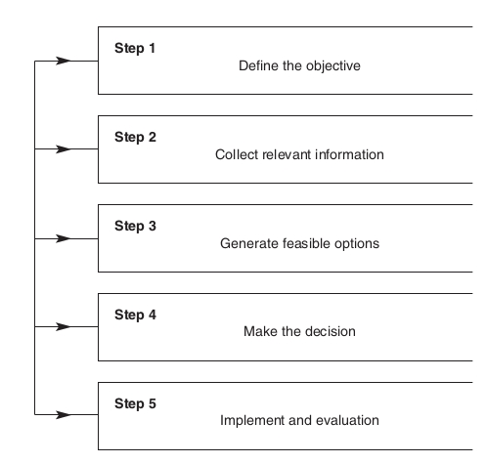

Effective Decision Making

Slide 3

Define the Objective
You do need to be clear about what you are trying to achieve

Slide 4
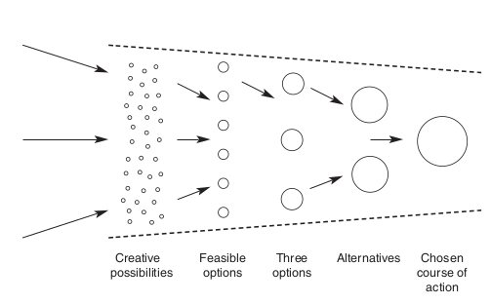
Feasible Options
Notice the word options
rather than alternatives

Slide 5
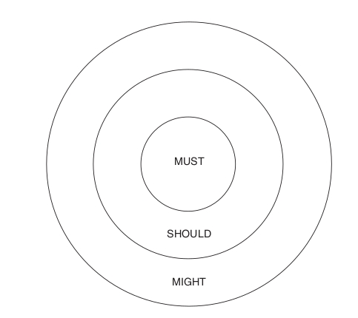
Make the decision
You have to establish the selection criteria

Slide 6
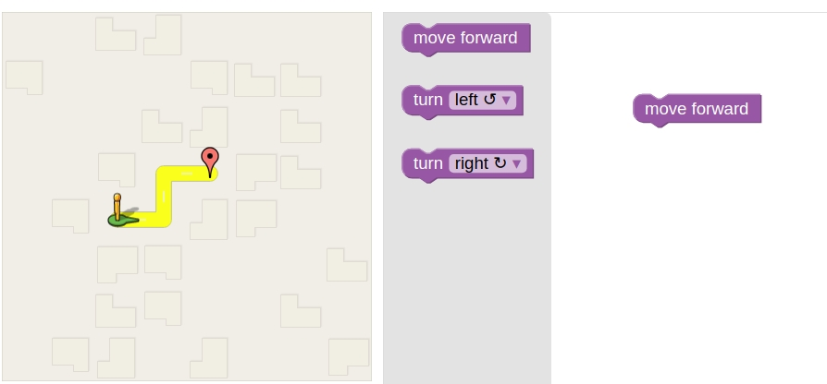
Problem 1

Slide 7

Problem 2

Slide 8



